Slide 1

RESEARCH METHODS
WELCOME
Course Teacher:
Prof. Khondaker A. Mamun
PhD. (Biomedical Engineering), University of Southampton, UK
Research Fellow (Biomedical Engineering), University of Toronto, Canada
Founder, CMED Health, A Preventive Healthcare Initiative
Founder and Director, Advanced Intelligent Multidisciplinary Systems Lab (AIMS Lab)
Professor, Dept. of CSE, United International University, Dhaka, Bangladesh
Email: mamun@cse.uiu.ac.bd
Mobile: 01776534220

Slide 2


Special Teaching Assistants:
Mr. …………..
Miss. …………..
Reward: Thank you

Slide 3
COURSE OBJECTIVES
This course reviews the major considerations and tasks involved in conducting research particularly as they pertain to the area of computer science.
We shall introduce the essential aspects of proposing, designing, supporting, conducting and reporting on research projects.

Slide 4

[TEXTBOOK]
Whitley, B.E. Jr.;
Principles of Research in Behavioral Science;
2nd edition; McGraw-Hill
ISBN 0-7674-2175-2
Will supply papers, documents and presentations
[TEXTBOOK] Optional

Slide 5
COMPUTING REQUIREMENTS
It is ESSENTIAL that the students have access to email and the World Wide Web for the successful participation in this course.
Access to a spreadsheet facility (e.g. Microsoft Excel) is also required.
Some course materials and assignments would be distributed as Microsoft Word documents. Soft copies of lecture notes would be in Microsoft PowerPoint. Students should at least have the capability to open and view these files.

Slide 6


FORMAT AND GRADING
Format:
There will be 12 classes spanning over 12 weeks
Classes may be actual or virtual (e.g. actually meet or material and work being provided with guidance throughout the week). In other words, the lecture component may be zero to three hours in a given week.
Grading:
Attendance 5%
Class Tests 20%
Assignments 5%
Midterm/Presentation/Proposal 30%
Final 40%

Slide 7

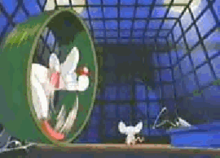
ACQUIRING KNOWLEDGE
Humankind needs to KNOW:
Who?
How?
When?
Where?
What?
Why?

Slide 8
ACQUIRING KNOWLEDGE
Tenacity: It has always been so
Intuition: I feel it is so
Authority: They say it is so
Rationalism: It makes sense for it to be so
Empiricism: Data suggests it to be so
Science: It can be demonstrated to be so

Slide 9
SCIENCE
Science is a way of thinking, a system of belief; it is a kind of RELIGION.
Science is a process of inquiry that brings together elements of both rationalism and empiricism. It employs rational logic and checks each premise, and each logical step with empirical observation.
Science is the inter-play of logic with observation

Slide 10
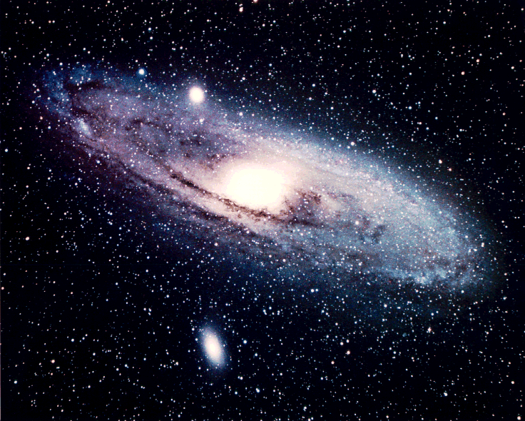

BASIC TENETS OF SCIENCE
A scientist believes that:
A true, physical and external universe exists
2. While there may be randomness and thus unpredictability in the universe, it is primarily an orderly system.

Slide 11
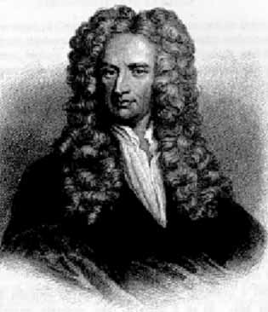
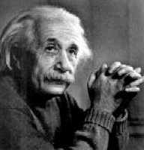
BASIC TENETS OF SCIENCE
The principles of this orderly universe can be discovered
4. Our knowledge of the universe is always incomplete. New knowledge can, should, and does alter current ideas.
E=Mc²
λ=h/mv
F=ma
ΔxΔp>h/2π
?

Slide 12
RESEARCH
Research is also a process of inquiry. It entails the following steps:
Posing a question
Developing a procedure to answer that question
Following that procedure.
However,
Not all research is scientific

Slide 13
SCIENTIFIC RESEARCH
Scientific research is the process of inquiry in which we:
Pose a question about the physical world
Develop a set of procedures using the rational process that if followed, would convincingly answer that question
Plan to make appropriate empirical observations
Rationally interpret the empirical observation to arrive at a conclusion.

Slide 14
TYPES OF RESEARCH
There is a continuum that defines various types of research not all of which is scientific research.
Mixed
DEDUCTION-INDUCTION
Applied Research
Technical (Engineering) Development
Pure/Basic/Fundamental Research
Technological (Engineering) Research
SCIENCE

Slide 15
SCIENTIFIC THEORY
The outcome of fundamental science is Scientific Theory.
Scientific Theory is a model of reality.
A model IS NOT reality but only REPRESENTS it.
Therefore
A theory is a formalized set of concepts that organizes observations and inferences and predicts and explains phenomena.

Slide 16
DEDUCTION-INDUCTION
Deduction
Deduction is the using of general facts to rationally arrive at a more specific conclusion (General to the specific):
Contrast
All ravens (Crow) are black, All ravens are black,
Molly is a raven, My laptop is black,
therefore therefore
Molly is black My laptop is a raven
I am a nobody, and nobody is perfect; therefore I am perfect.

Slide 17
DEDUCTION-INDUCTION
Induction:
Induction moves from the specific to the general.
Cat A has a tail,
Cat B has a tail,
Cat C has a tail,
Cat D has a tail,
::::::::::::::::::::::
therefore
All cats have tails.

Slide 18
DEDUCTION-INDUCTION
Deductive reasoning usually EXPLAINS.
Inductive reasoning usually PREDICTS.
Science is deducto-inductive.
The premises are inductively validated and the conclusion is deductively reached.
The deducto-inductive approach is also called functionalism.

Slide 19
LEVELS OF CONSTRAINT
Not all science puts the same constraints on the researcher. Some approaches place little demand on the adequacy of the information and the nature of the processing of that information, some place high demands. Therefore within science, there is a scale of scientific methods; some more demanding and exact than other.
Remember however that they ALL are scientific and they ALL are useful. Just that each is appropriate for a particular set of circumstances.

Slide 20
LEVELS OF CONSTRAINT
The levels of constraint on scientific research are:
Naturalistic observation
Case-study method
Correlational research
Differential research
Experimental research
This spans a spectrum from qualitative means to quantitative ones.

